Slide 1

Bank Loan Case Study
By Satyashree Sahu Pawar

Slide 2

Project Overview:
This project involves a data analysis task for a finance company specializing in lending various types of loans to urban customers. The primary challenge faced by the company is the occurrence of loan defaults, especially among customers with insufficient credit history. The goal is to utilize Exploratory Data Analysis (EDA) to understand patterns in the data and ensure that qualified applicants are not rejected while minimizing the risk of financial loss due to defaults.

Slide 3
Approach
Handling Missing Data:
I employed the COUNTA function to determine the total number of rows in each column.
Next, I filtered out columns with null value percentages exceeding 30%. For columns with less than 30% null value percentages, I performed imputations using the mean, median, and mode for the missing values.
Detecting Outliers:
I identified outliers by applying functions like QUARTILE, IQR to pertinent columns in the dataset.
Visualize outliers using scatter plots.
Subsequently, I calculated the percentage of null values in each column using the formula [1 - (Total Row Counts for each column / Total Row Counts)].

Slide 4
Approach
Analyzing Data Imbalance:
Used Excel functions like COUNTIF and SUM to calculate class proportions.
Univariate, Segmented, and Bivariate Analysis:
Leverage Excel functions such as COUNT, AVERAGE, MEDIAN, and statistical functions for descriptive analysis.
Created a bar chart to visually represent the distribution of the target variable and highlight data imbalance.
Use filters, sorting, and pivot tables for segmented and bivariate analysis.
Visualize distributions, comparisons, and relationships using histograms, bar charts, box plots, stacked bar charts, and scatter plots
Identifying Top Correlations:
Utilize Excel functions like CORREL to calculate correlation coefficients within each segment.
Rank and visualize correlations using correlation matrices or heatmaps.

Slide 5


Tech Stack Used
Microsoft EXCEL 365
The entire analysis was conducted using Excel 365, leveraging its functionalities for statistical computations and data manipulation. Furthermore, Excel was employed to generate graphical representations, facilitating a clearer understanding of the obtained results.
365

Slide 6
IDENTIFY MISSING DATA
Number of Rows =50000 | Number of Columns=122
COUNTA function to determine the total number of rows in each column.
The percentage of null values in each column using the formula [1 - (Total Row Counts for each column / Total Row Counts)].
Drop those columns with missing value % greater than 30%.
There are 52 columns with null value more than 30%.So the new rows is 50000 and column 70.
Convert negative days to years by using formula ROUND(ABS(value/365),0)

Slide 7
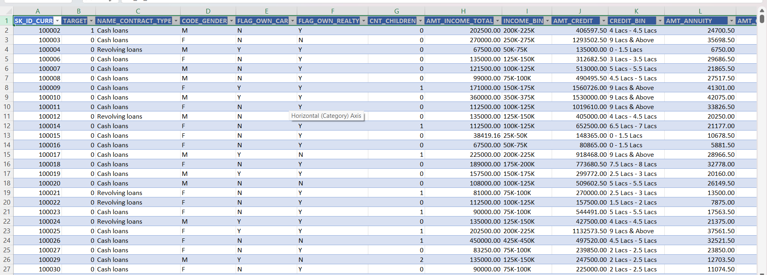

Slide 8
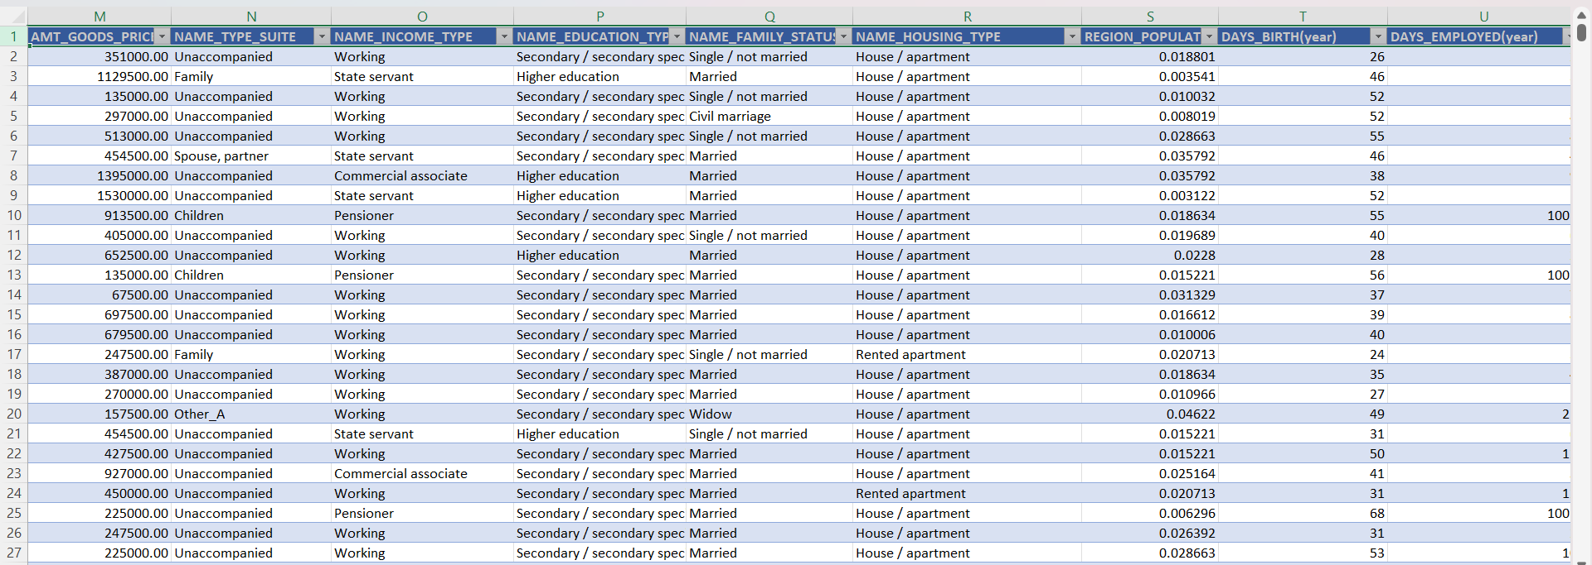

Slide 9
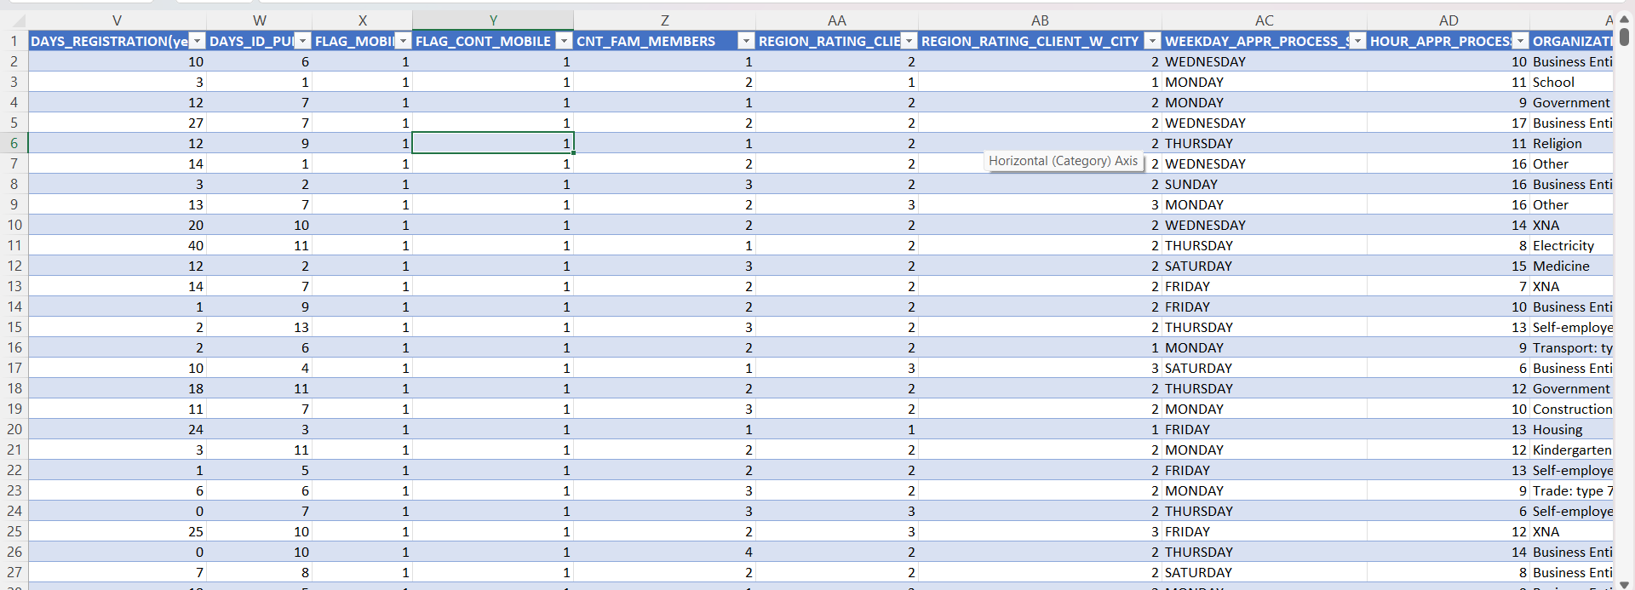

Slide 10
OUTLIERS
In the above XY plotter we can see that for the target variable 1 there are income which are beyond the limit. There are applicants who are drawing an income of around 11 crores whereas majority of applicants are drawing income in lacs only. For analysis refer the sheet outliers for AMT_TOTAL_INCOME in the given link.

Slide 11
In the sheet outliers for CNT_CHILDREN there are outliers for the target column 0 and as well as 1. The XY Plotter for 0 shows 12 children which is highly unusual these days. The XY plotter for 1 shows more than 7 children.

Slide 12
In the sheet outliers for Days Employed there are outliers for both target column 0 and 1. The XY plotter shows there are applicants being employed for 1000 years from the day of application which is clearly an anomaly.

Slide 13
DATA IMBALANCE
In the excel file attached above the sheet Data imbalance shows the ratio of total applicants with payment difficulties (1) to the total applicants with installments being paid on time (0) to be 11.39. That is out of total applications of 49999, 92% applicants paid installments on time thus makes the majority class and the rest of the 8% of applicants had payment difficulties thus makes the minority class.

Slide 14
Perform Univariate, Segmented Univariate, and Bivariate Analysis
UNIVARIATE ANALYSIS
Univariate Analysis refers to the analysis of data that contains only one variable. It does not deal with causes or relationships and the main purpose of the analysis is to describe the data and find patterns that exist within it. The above graph is an example of univariate analysis which depicts simply the count of applicants for the variable AMT_CREDIT grouped in different credit bins. Majority of the applicants were offered loans in the credit range of 9 Lacs and above.

Slide 16
UNIVARIAITE SEGMENTED ANALYSIS
Univariate Analysis refers to the analysis of data that contains only one variable. Segmented analysis here means that the data variable is analyzed in subsets. The above graph is an example of univariate segmented analysis which depicts simply the count of segmented applicants (0 & 1) for the variable AMT_TOTAL_INCOME grouped in different income bins. As evident from the graph there are very few targets 1 applicant who draw an income of more than 50 Lacs and above which can be the reason for the difficulties in the payments. Also, maximum applicants (0,1) draw an income between 1.25 Lacs to 1.5 Lacs but there are applicants which are having payment difficulties despite belonging to the same income range.

Slide 18
BIVARIAITE ANALYSIS
Bivariate Analysis refers to the analysis of data that contains only two variables. The analysis of this type of data deals with causes and relationships and the analysis is done to find out the relationship among the two variables. The above graph is an example of bivariate analysis which depicts the relation between AMT_CREDIT and AMT_TOTAL_INCOME. As evident from the graph applicants drawing higher income were offered higher loan amount. Thus, these two variables follow a directionally proportional relation.

Slide 20
TOP CORRELATIONS FOR DIFFERENT SCENARIOS
Correlations For Applicants With Payment Made On Time
The heat map in the below slide shows the correlations between the different variables for the target (0) that is applicants with no payment difficulties.
The color scheme used for the heat map in the above slide is Yellow to Orange which indicates the strongest correlations are in green and the weakest correlations being in whites.
The most relevant correlations can be seen between the variables are:
• AMT_TOTAL_INCOME to AMT_CREDIT
• DAYS_EMPLOYED to DAYS_BIRTH
• REGION_POPULATION_RELATIVE to AMT_INCOME_TOTAL

Slide 21
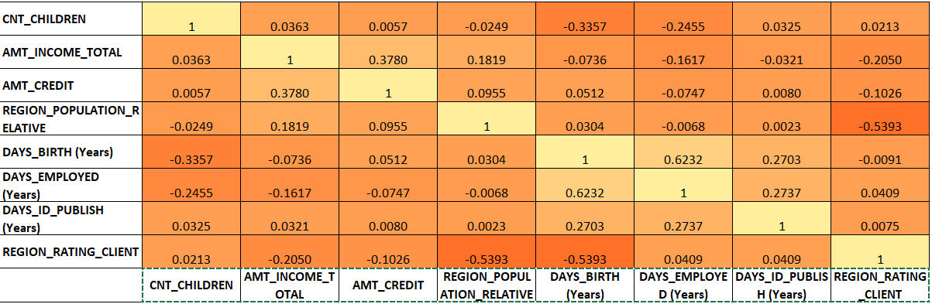

Slide 22
TOP CORRELATIONS FOR DIFFERENT SCENARIOS
2.CORRELATIONS FOR APPLICANTS WITH PAYMENT DIFFICULTIES
The heat map in the below slide shows the correlations between the different variables for the target (1) that is applicants with no payment difficulties.
The color scheme used for the heat map in the above slide is Yellow to Orange which indicates the strongest correlations are in green and the weakest correlations being in whites.
The most relevant correlations can be seen between the variables are:
• AMT_TOTAL_INCOME to AMT_CREDIT
• DAYS_EMPLOYED to DAYS_BIRTH
• REGION_POPULATION_RELATIVE to AMT_INCOME_TOTAL

Slide 23
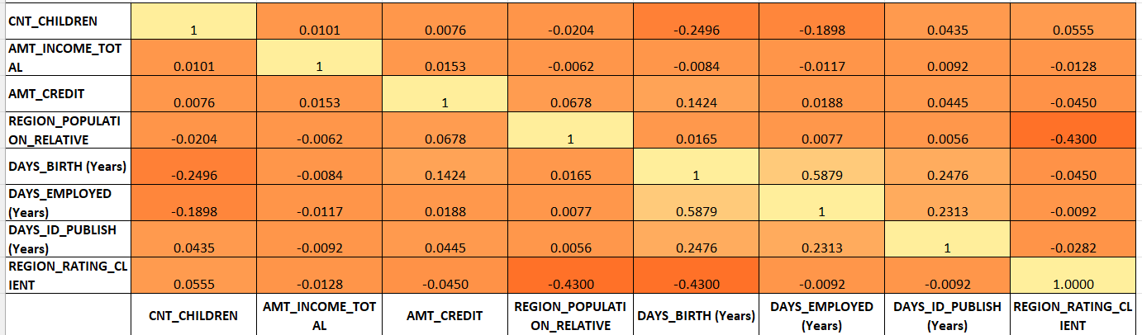

Slide 24
CONCLUSION
This project helps in handling the large datasets. How exploratory data analysis can be applied to large datasets. When dealing with the large datasets it is also important to select only those columns which are extremely useful to our analysis. Finding correlations columns can become very convenient while dealing with large datasets as it saves time selecting which columns should be considered for analysis. The project also helps in understanding the various terminologies used in the banking domain. The insight drawn from the project are as follows:
Applicants drawing higher income were offered higher loan amount by the bank.
Majority of applicants drawn an income range between 1.25 Lacs – 1.5 Lacs, also the defaults drawn income between the same range.
Majority of applicants were offered loans in the credit range of 9 Lacs and above.

Slide 25
THANK YOU

